Slide 1
What's Cooking ?
Categorizing Cuisines based on Ingredients
SpringBoard: Foundations of Data science workshop
Bimal Chalasani
Aug 2016

Slide 2
Contents
Background
Topics
Data Set
Data Wrangling
Exploratory Data Analysis
Regression Models
Future Work

Slide 3
Background
Business Analysis (Excel,VBA)
Data Science (R, Python)
Data Analysis (SQL,SAS)
Entrepreneur
Domain: Finance
6+ years Exp
Education: B.Tech, NIT
Progression

Slide 4
Topics
Kaggle: What's Cooking
Categorizing Cuisine based on Ingredients
Capital One :
Predicting the buying pattern using twitter hash tags based on weather !
Kaggle : Airbnb
Predict which country does new USA Airbnb users will choose
☑

Slide 5
Data Set
Format:
{ "id": 24717, "cuisine": "indian", "ingredients": [ "tumeric", "vegetable stock", "tomatoes", "garam masala", "naan", "red lentils", "red chili peppers", "onions", "spinach", "sweet potatoes" ] },
Data set from Kaggle Data competition whats cooking https://www.kaggle.com/c/whats-cooking/data
Dependent variable: Cuisine
Independent variable :ingredients

Slide 6
Data Wrangling
Unnest + Dummy var
Corpus
Corpus
Issues with data
Numerical values
Punctuations , brackets
Lower/upper Case
Unique Ingredients: 2671
Total Cuisines : 39774

Slide 7
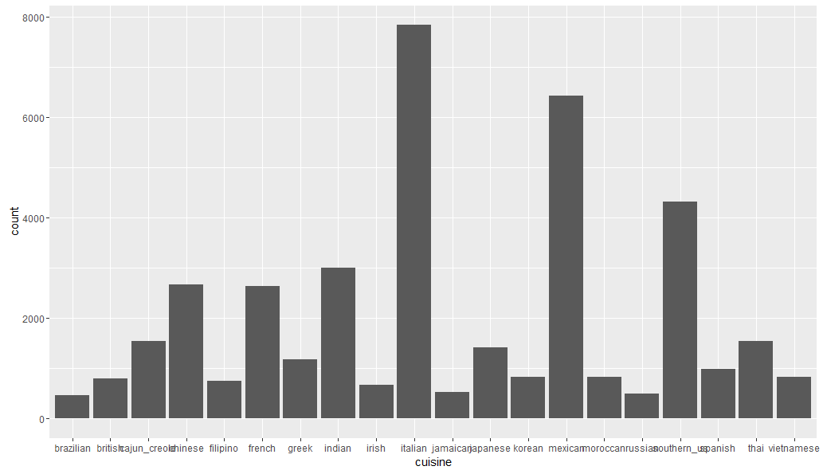
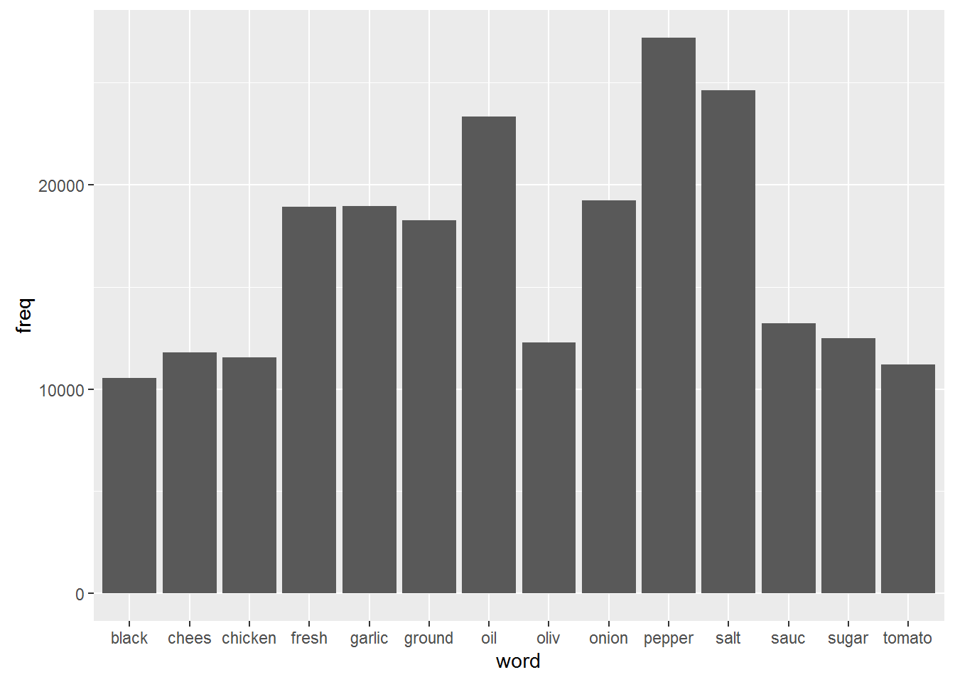
Exploratory Data Analysis
Frequency of Cuisines
Frequency of Ingredients

Slide 8
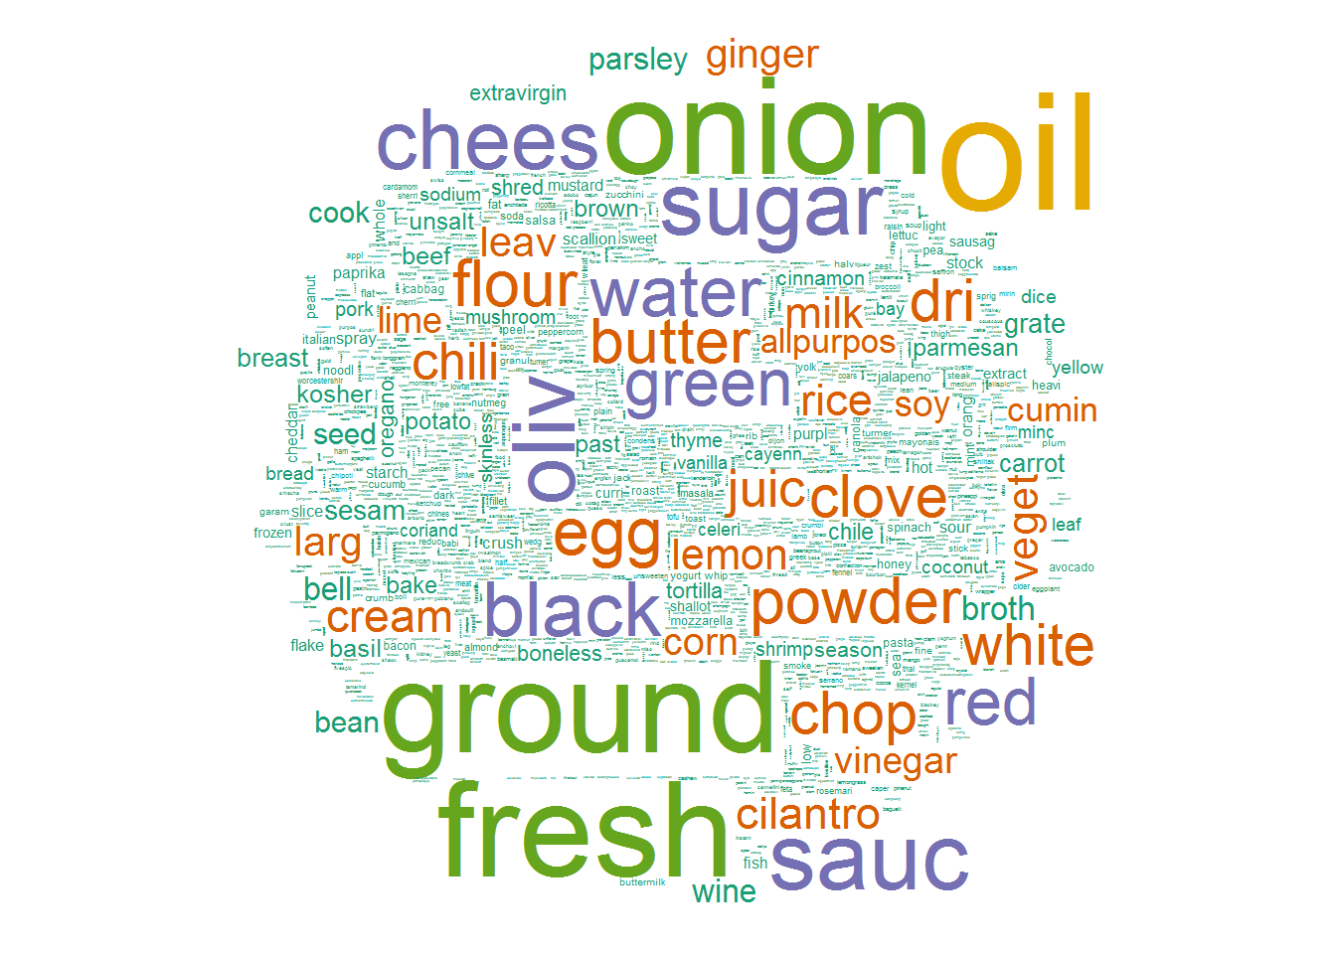
Exploratory Data Analysis
Word Cloud: Most used words

Slide 9
Regression Models
Model# | Variation | Accuracy
Model1 | Using Most used ingredient | 40.96%
Model2 | Using all ingredients | 42.03%
Model3 | Using PCA | 41.09%

Slide 10
Regression Models
In Model 1 Using the most used ingredients resulted in lesser accuracy, this might be because the ingredients less used are also a good factor in determining the cuisine.
Using all the ingredients bumped up the accuracy a little bit.
Interestingly, model using PCA is less accurate than model using all ingredients

Slide 11
Future work
Model using XgBoost
Visualizing popular cuisines in different countries based on the cuisine categorization and twitter data!
For a new restaurant, can we predict cuisines which may become the best cuisines given an area/country?

Slide 12
Acknowledgements
Amit Dingare
Springboard Team

Slide 13
Q&A

